Slide 1
Boyton Primary School Newsletter
Friday 11th October 2024
Email:boyton@andaras.org

Slide 2
Dear Parents,
Firstly, thank you so much for joining us on Wednesday for our Harvest celebrations. It was so lovely to see the hall filled! We were all very proud of the children – it takes so much courage to stand up in front of an audience – particularly when the audience is so close! Thank you also for all the kind donations of produce for the Foodbank. I know it will be very gratefully received.
I have been really impressed with the Art being undertaken in both classes currently! Acorns and Birch class undertook a challenge to draw a still-life without taking their charcoal/ pens off the paper. They were all really observant and did a super job! Chestnuts’ focus is on ‘Exploring Identity’ – they too have been really developing their skills in observational drawing using a range of media. I’m looking forward to seeing their finished pieces.
On Saturday, we are looking forward to participating in Launceston Carnival
with Werrington and North Petherwin Primary schools! The theme is
‘numbers’ and we will be meeting at Newport Industrial Estate from 5pm,
ready for judging to commence at 6pm. All children must be accompanied
by an adult. Thank you. We look forward to seeing you there!
The term seems to be flying – only a couple of weeks until half term. As always, if you should have any worries or concerns, please don’t hesitate to get in touch. We wish you a very lovely weekend.
Best wishes
Mrs Davies kdavies@andaras.org

Slide 3
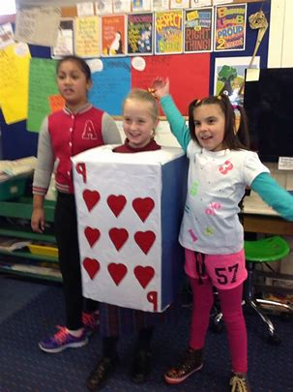
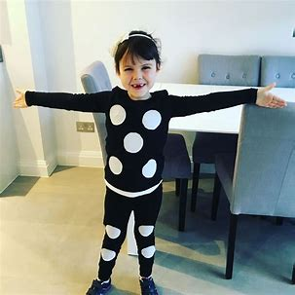
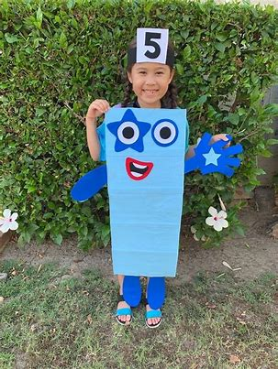
Dates for Your Diary
Forthcoming events
Launceston carnival – Saturday 12th October
Nasal flu vaccinations Tuesday 22nd October
‘Read with me’ – parents/children whole school reading session - Wednesday 23rd October 9.05am
Halloween disco (PTA) – Thursday 24th October
INSET - Friday 25th October (School is closed for children)
Book Fayre at school – Mon 11th Nov – 18th Nov
Wednesday 4th December / Wednesday 11th December – Acorns and Birch visit to the Woodland Skill Centre
PTA Bingo! 6th Dec – Boyton Parish hall
Family Christmas lunch – Wednesday 18th December (More details to follow!)
School breaks up for Christmas! – Friday 20th December
Launceston Carnival - meeting from 5pm for 6pm judging.
Brilliance at Boyton: This week’s Stars
Whole School to Date | 93.8%
Acorns This Week | 98.21%
Birch This Week | 100%
Chestnut This Week | 97.27%
Attendance (Target 96% or above)
Acorn / Birch
Chestnuts –

Slide 4
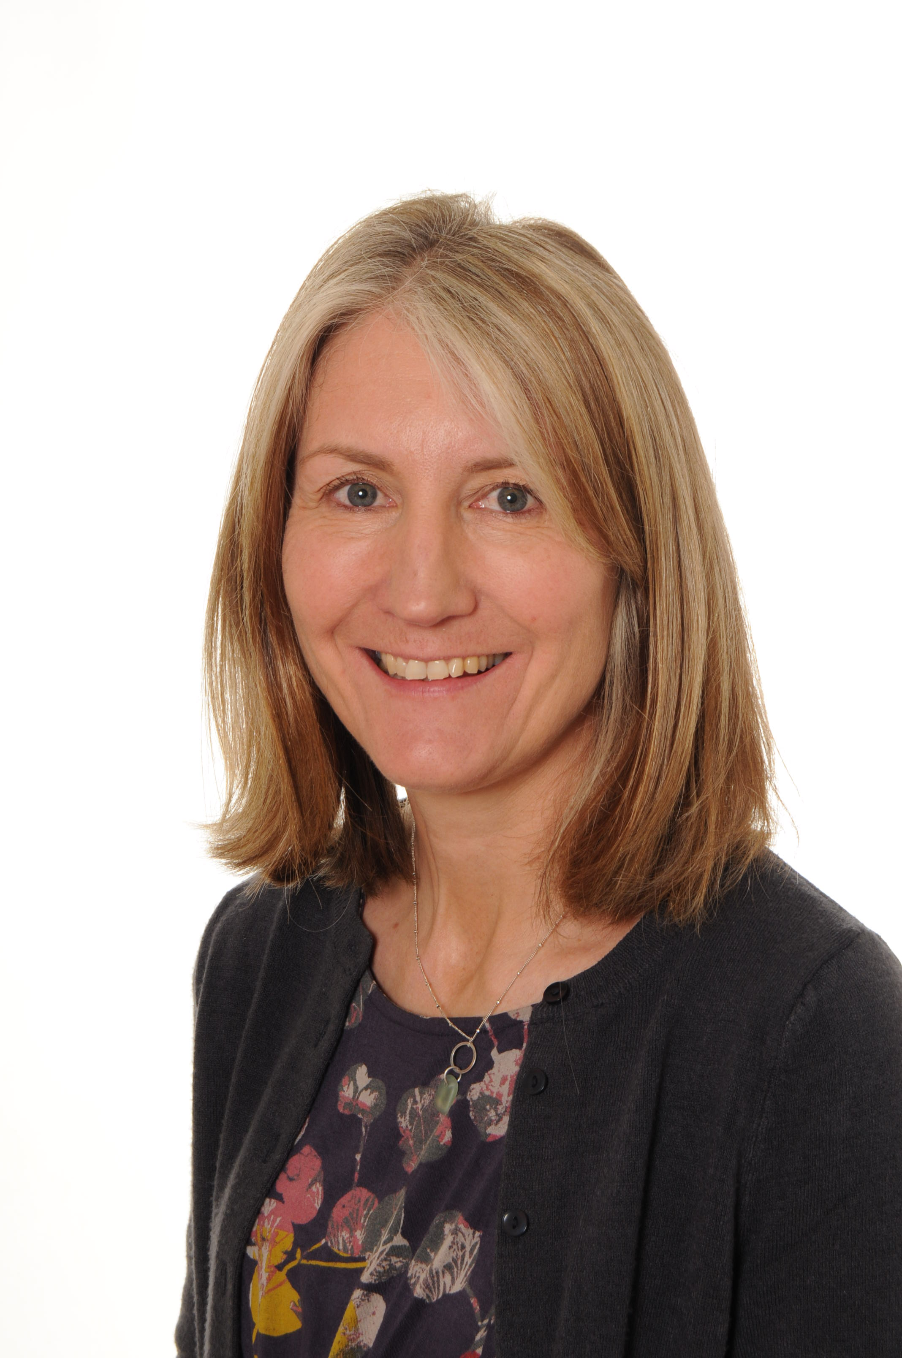
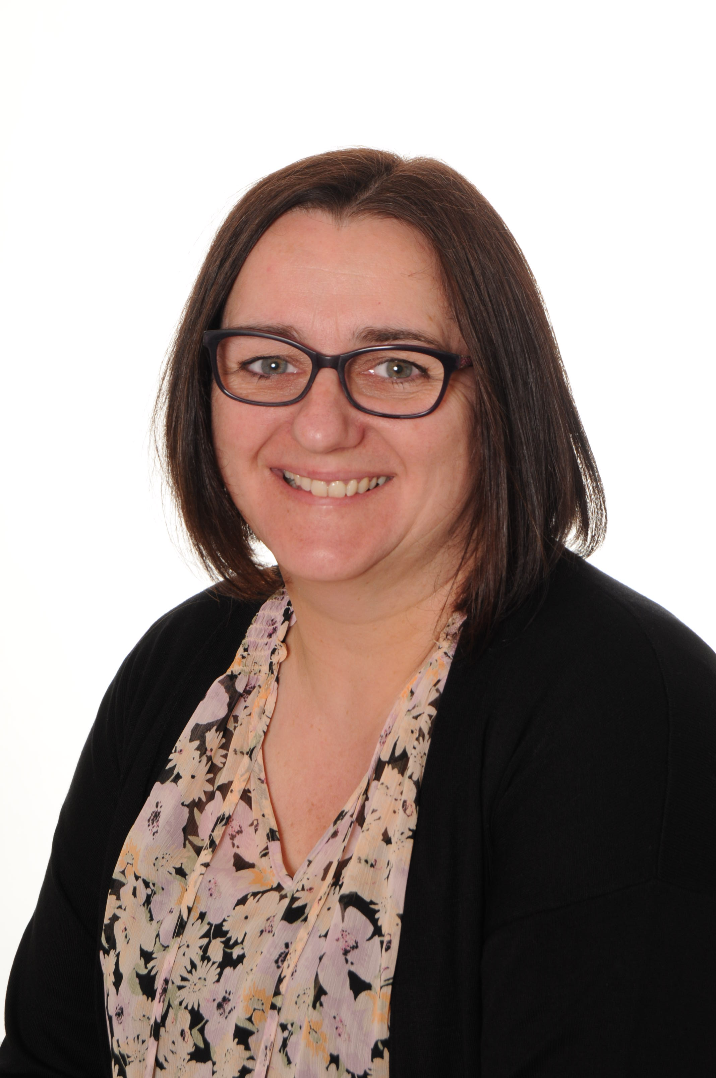
Useful Information
School Clubs
Breakfast Club:
At Boyton, we are really lucky to have a fantastic Breakfast Club run by Tracy. Children can be dropped off from 8.15am and have a choice of breakfasts including cereals, toast, etc. It costs £2 a session. If you would like to book your child in, please let Mrs Basford in the school office know.
secretary@boyton.cornwall.sch.uk
After School Clubs Autumn Term 2024:
Monday
Eco / Sustainability club – Jo Williams
Tuesday
Film club - Miss Kinver
Thursday
Board game club – Mrs Davies
Safeguarding
All children have a right to be safe, no matter who they are or what their circumstances.
Keeping children safe is everyone’s responsibility.
If you are concerned about a child, please speak to one of the Designated safeguarding Leads. If a child is in immediate danger contact the police on 999.
Katherine Davies
Safeguarding Lead
Jane Gilman
Deputy Safeguarding Lead
Useful numbers
Early Help Hub | 01872 322277
Citizens Advice | 0344 411 1444
NSPCC | 0808 800 5000
Childline | 0800 1111
Addiction: Drug and Alcohol support | 01579 340616 (24hrs)
Multi-Agency Referral Unit (MARU) | 0300 123 1116 (If you are concerned about a child’s safety)

Slide 5
Chestnut Class

Slide 6
School Calendar 2023/2024

