Slide 1
Visible learning
What is it? Professional development for teachers and leaders that explores how evidence can be used to create innovation in the learning environment.
When John Hattie first began his research around performance indicators and evaluation in education, he had one simple question: which variables have the greatest impact on student achievement?

Slide 2
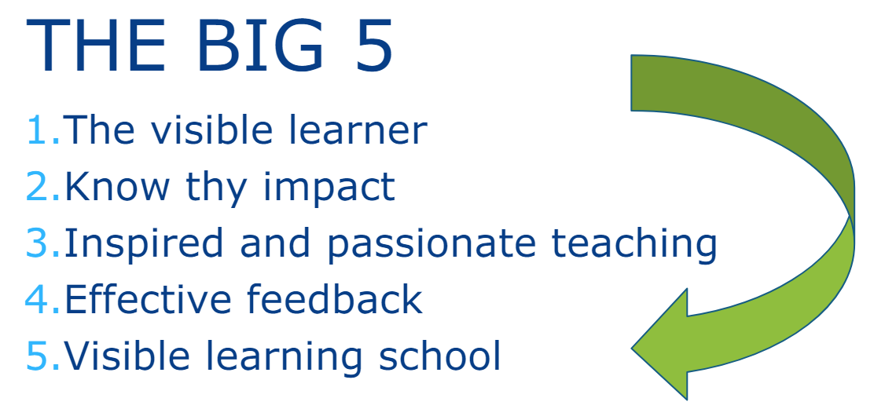
Visible learning

Slide 3
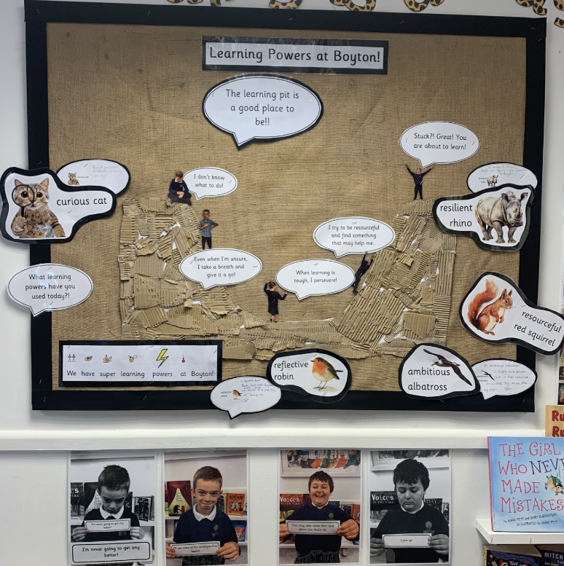
Visible learning – photo of a learning pit and our learning powers.
As a school, in an assembly we discussed what we thought a ‘good learner’ does. We initially chose eight and then whittled it down to five – these became the school ‘learning powers’!
Curious cat
Resilient rhino
Reflective robin
Resourceful red squirrel
Ambitious albatross
Our learning powers are woven into all we do and certificates are awarded in weekly celebration assemblies to celebrate those who have used super learning powers during the week.

